Slide 1
CENTRIXS Account Creation Process

Slide 2
CENTRIXS Account Creation Process
To obtain a MPE CENTRIXS Account, the following items must be properly and accurately completed before any action can take place. **Any missing information or documentation will stop accounts from being created**
Required Documents: USINDOPACOM MPE-ES DD2875 and Current FY Cyber Awareness Certificate
USINDOPACOM MPE-ES DD2875 can be found on SharePoint site at https://intelshare.intelink.gov/sites/mnis/support
Scroll over and select USINDOPACOM MPE CENTRIXS Forms (Red Arrow)
Download and Complete “MPE CENTRIXS 2875 Regular User” Form
Completing MPE 2875 Account Request Form
Type of Request: Initial
System Name: REL “X” & MLCNET
NOTE: X = J, K, CMFP and/or FVEY
MLCNET is required for thin client access
Part I (Requestor’s Info): All Blocks
Part II (Supervisor/Sponsor): Blocks 13, 14, 17-20b
Part III (Unit Security Manager): All Blocks
NOTE: For C7F Personnel contact the C7F SECMAN Distro(s):
C7F-Security-Manager@c7f.navy.mil
Obtain CURRENT FY DoD Cyber Awareness Challenge Certificate
Scroll over and select Submit NEW User Account Request (Green Arrow)

Slide 3
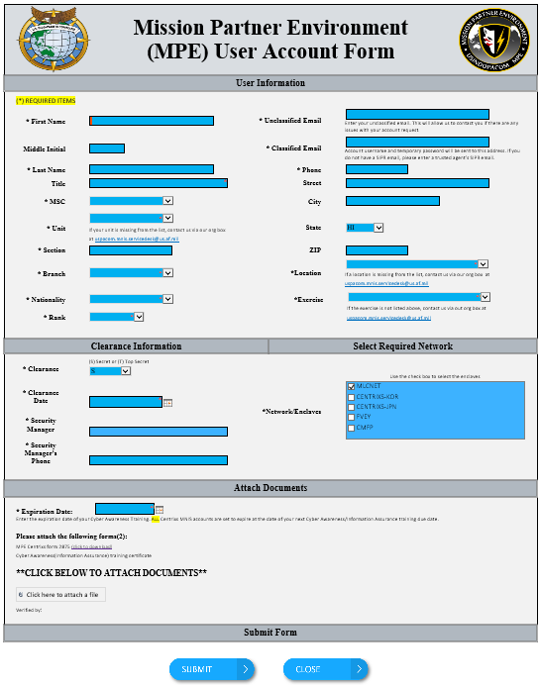
CENTRIXS Account Creation Process
Complete all required fields marked with an asterisk ( * ) on “MPE User Account Form” page
Attach 2875 and Current Cyber Awareness Certificate (GREEN ARROW)
Click “Submit” when required information and documents are uploaded
NOTE: The “Unclassified Email” provided on the SharePoint request form will receive status notifications of the CENTRIXS Account Request. (RED ARROW)
*Foreign Nationals*
Fill out parts 1 and 2 of the 2875 form
Forward 2875 form to US Sponsoring Unit Security Manager to complete part 3
Provide a current copy of the DOD/Cyber Awareness or equivalent certification as required by the FN’s country
U.S Sponsor Submits New User Account Request via MPE Service Desk Site
Allow up to 72 HRS for account creation once USINDOPACOM MPE-ES DD2875 and Cyber Awareness Certificate have been verified.
USINDOPACOM MPE Service Desk Team:
COM 808-789-6000/6010 | DSN 315-447-6000/6010 (N)uspacom.mnis.servicedesk@us.af.mil
(S) uspacom.mnis.servicedesk@paoc.hickam.af.smil.mil

